Slide 1
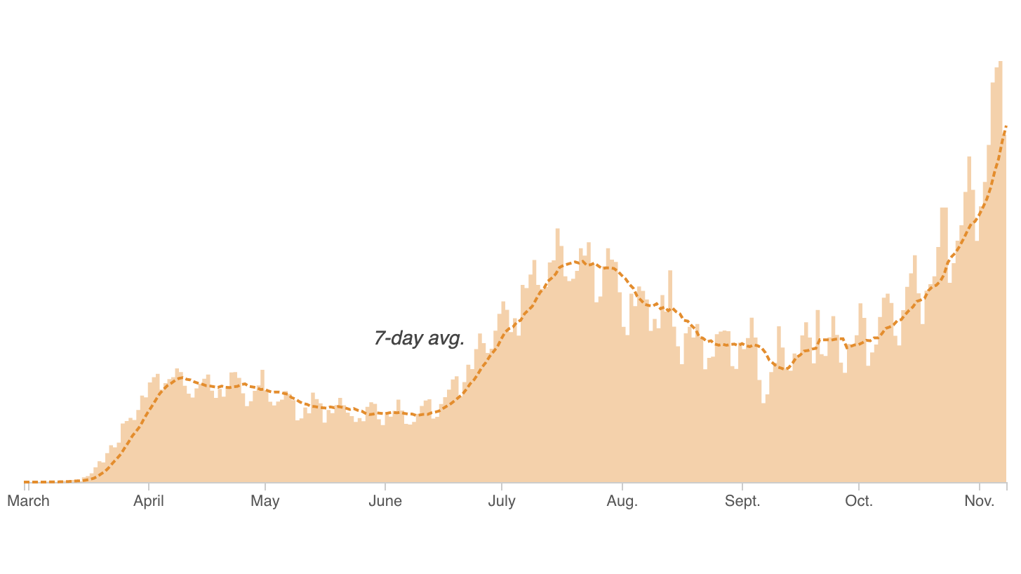

Slide 2
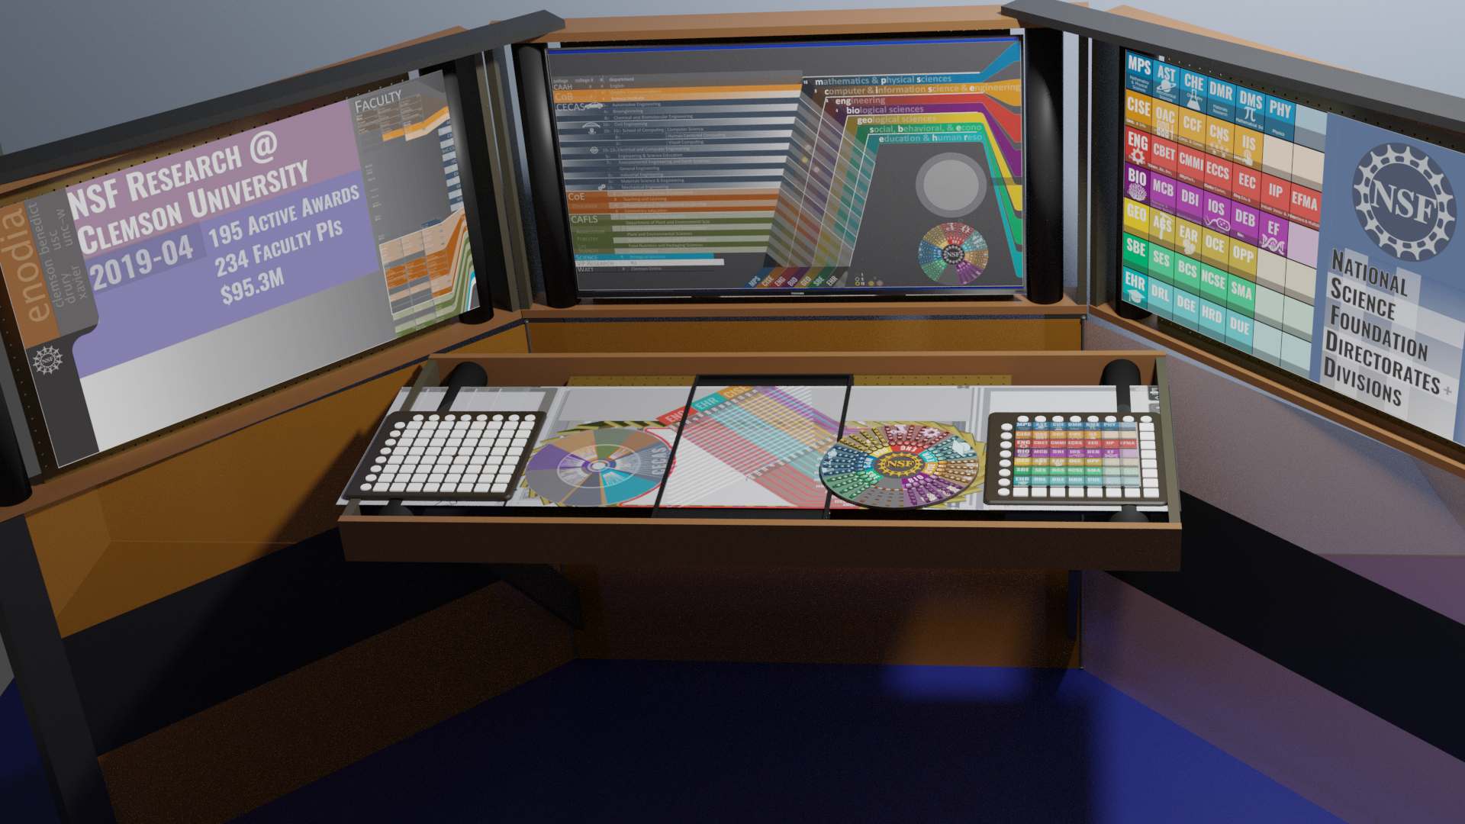
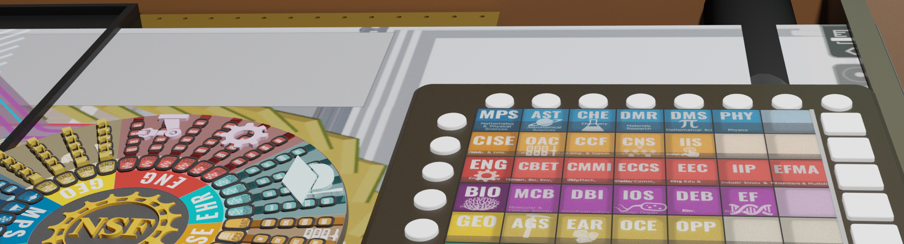

Slide 3
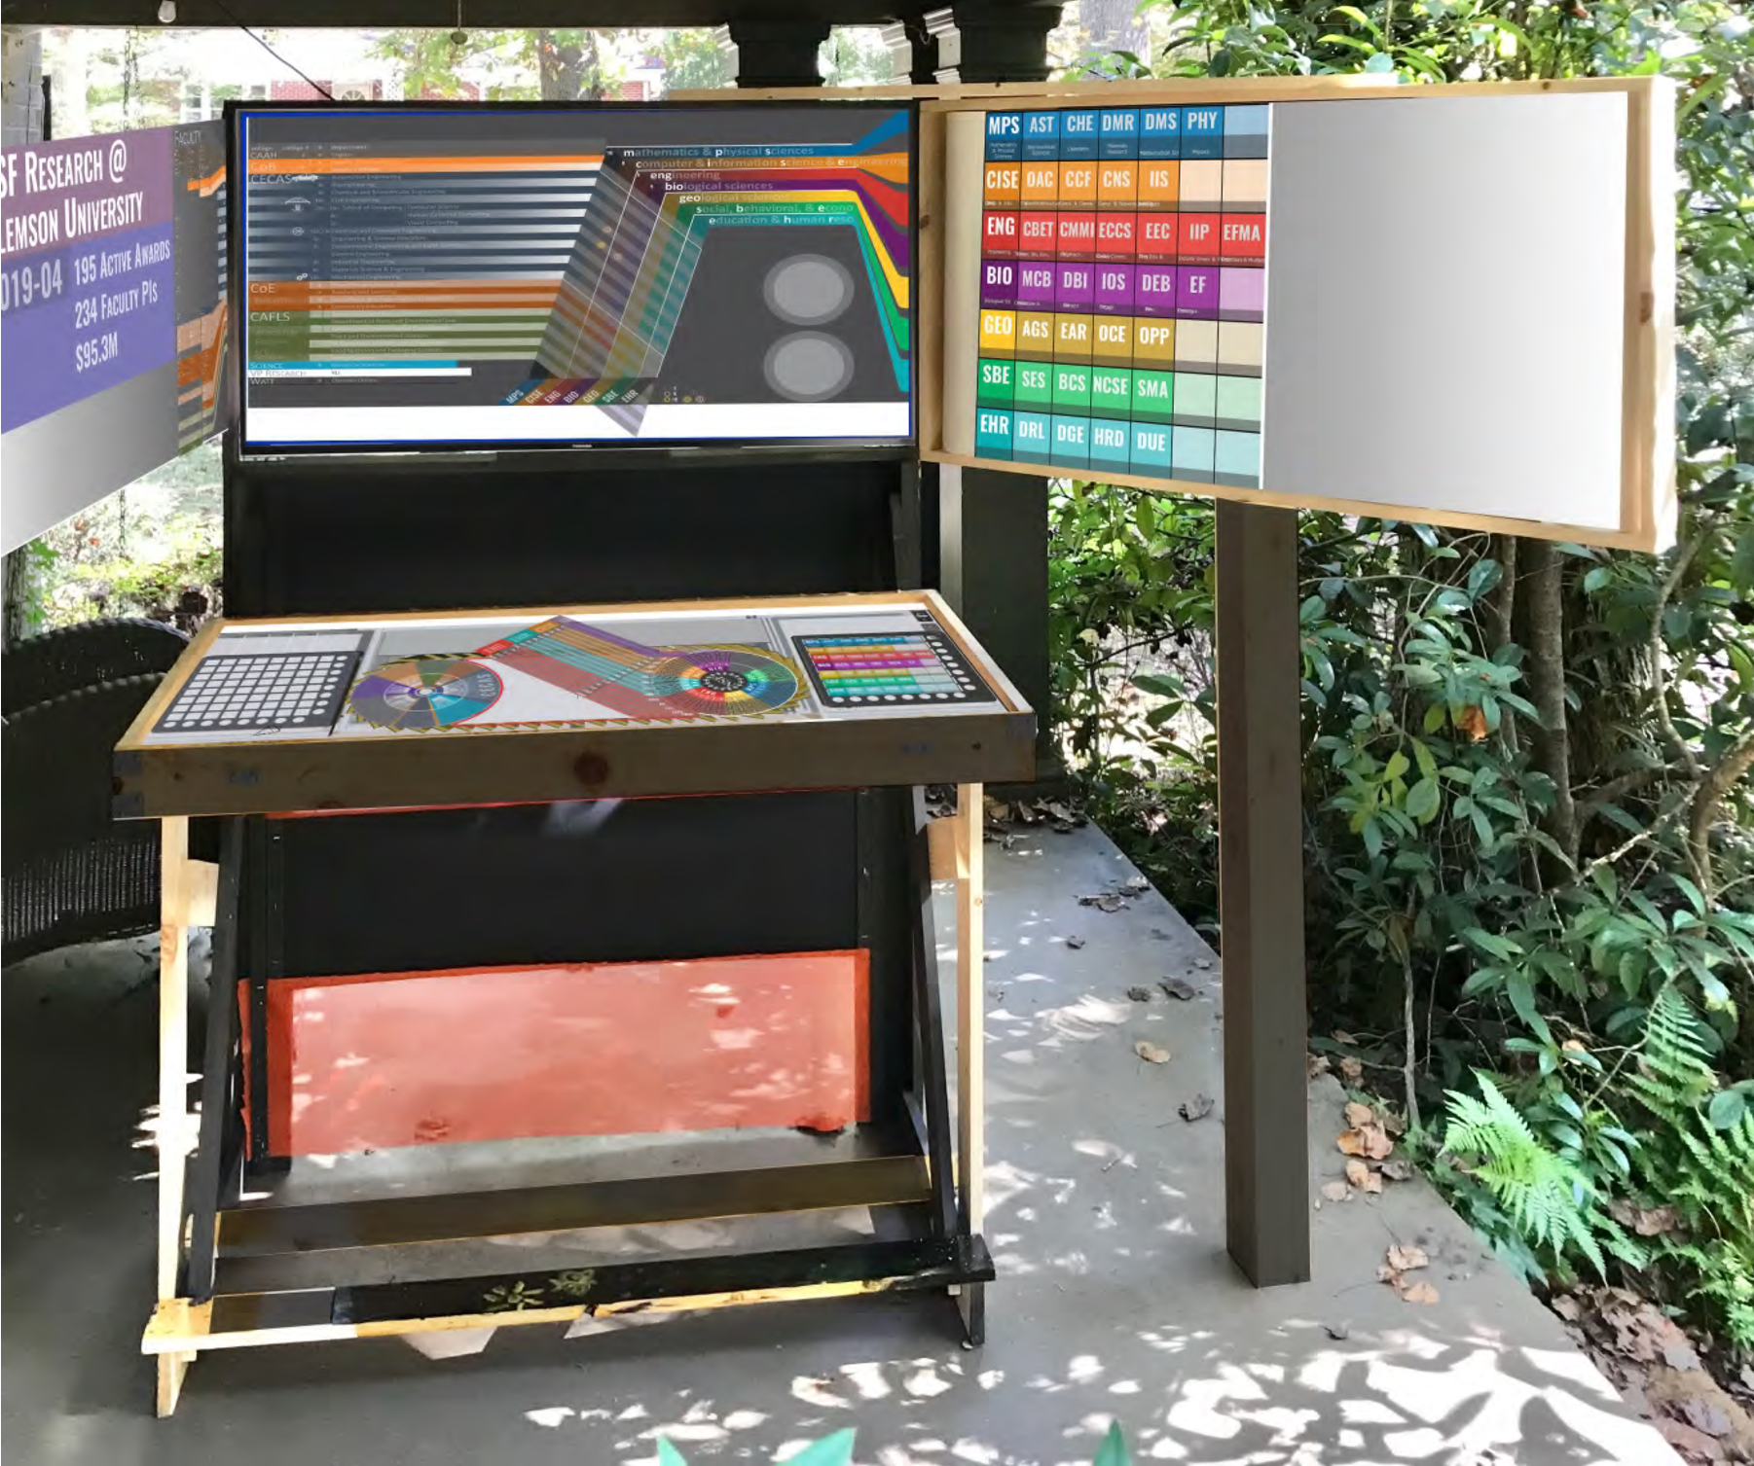

Slide 4
File System Reliability

Slide 5
Main Points
Problem posed by machine/disk failures
Transaction concept
Reliability
Careful sequencing of file system operations
Copy-on-write (WAFL, ZFS)
Journalling (NTFS, linux ext4)
Log structure (flash storage)
Availability
RAID

Slide 6
File System Reliability
What can happen if disk loses power or machine software crashes?
Some operations in progress may complete
Some operations in progress may be lost
Overwrite of a block may only partially complete
File system wants durability (as a minimum!)
Data previously stored can be retrieved (maybe after some recovery step), regardless of failure

Slide 7
Storage Reliability Problem
Single logical file operation can involve updates to multiple physical disk blocks
inode, indirect block, data block, bitmap, …
With remapping, single update to physical disk block can require multiple (even lower level) updates
At a physical level, operations complete one at a time
Want concurrent operations for performance
How do we guarantee consistency regardless of when crash occurs?

Slide 8
Transaction Concept
Transaction is a group of operations
Atomic: operations appear to happen as a group, or not at all (at logical level)
At physical level, only single disk/flash write is atomic
Durable: operations that complete stay completed
Future failures do not corrupt previously stored data
Isolation: other transactions do not see results of earlier transactions until they are committed
Consistency: sequential memory model

Slide 9
Storage Availability
Storage reliability: data fetched is what you stored
Transactions, redo logging, etc.
Storage availability: data is there when you want it
More disks => higher probability of some disk failing
Data available ~ Prob(disk working)^k
If failures are independent and data is spread across k disks
For large k, probability system works -> 0

Slide 10
RAID
Replicate data for availability
RAID 0: striping; no replication
RAID 1: mirror data across two or more disks
Google File System replicated its data on three disks, spread across multiple racks
RAID 5: split data across disks, with redundancy to recover from a single disk failure
RAID 6: RAID 5, with extra redundancy to recover from two disk failures
RAID 10: 1 + 0

Slide 11
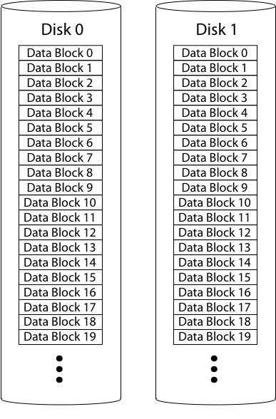
RAID 1: Mirroring
Replicate writes to both disks
Reads can go to either disk

Slide 12
Parity
Parity block: Block1 xor block2 xor block3 …
10001101 block1
01101100 block2
11000110 block3
--------------
00100111 parity block
Can reconstruct any missing block from the others

Slide 13
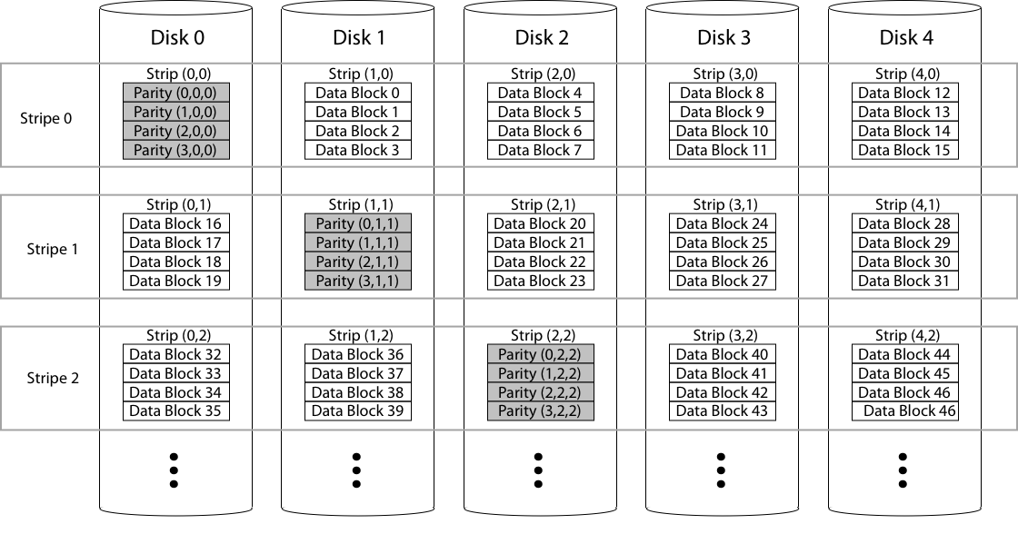
RAID 5: Rotating Parity

Slide 14
RAID Update
Mirroring
Write every mirror
RAID-5: to write one block
Read old data block
Read old parity block
Write new data block
Write new parity block
Old data xor old parity xor new data
RAID-5: to write entire stripe
Write data blocks and parity

Slide 15
Non-Recoverable Read Errors
Disk devices can lose data
One sector per 10^15 bits read
Causes:
Physical wear
Repeated writes to nearby tracks
What impact does this have on RAID recovery?

Slide 16
Read Errors and RAID recovery
Example
10 1 TB disks, and 1 fails
Read remaining disks to reconstruct missing data
Probability of recovery =
(1 – 10^15)^(9 disks * 8 bits * 10^12 bytes/disk)
= 93%
Solutions:
RAID-6: two redundant disk blocks
parity, linear feedback shift
Scrubbing: read disk sectors in background to find and fix latent errors

